Slide 1
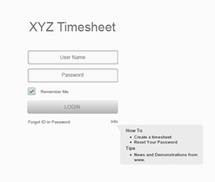
TIMESHEET LOGIN WINDOW
This is the login window using which the user can login to his timesheet by entering his username and password.
User has to enter his
username
in this field
User has to enter
His password
in this field
If user forgets his
password he can click
on this link and
get a new password to
his email id by entering
the security question
and answer.
Help feature
for using
timesheet

Slide 2
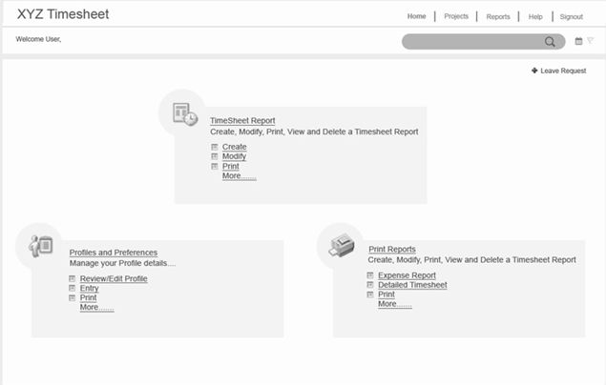
HOME PAGE
This is the home page wherein we can choose from the respective options.
User can create
or view or modify
or print or delete
user timesheet
Global search
Manage configuration
features
User can get
his detailed
timesheet report

Slide 3
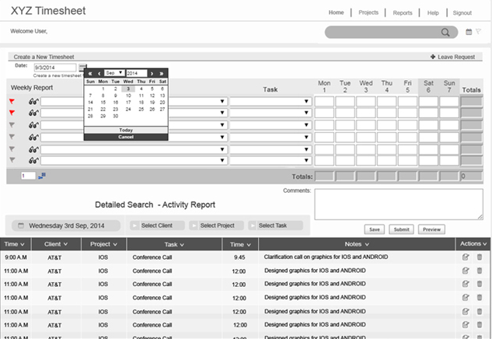
TimeSheet
Main menu
buttons

Slide 4
Timesheet
Flag and view feature
For timesheet
Drop down to
select project from
existing list
Drop down for selecting
respective task done
during project
Manually enter the
hours spent on project
work or automatically
calculate using swipe in
and out
Total number of hours
worked on
particular week

Slide 5
Timesheet
Textfield to enter the
number of rows
required for timesheet
Can choose the date
for filling the
timesheet
Can apply leave from
timesheet
Displays total working
hours for particular day
You can add
extra details to the
task done for project
To save the
description
that is added
Detailed report about
User projects and
timesheet.

